Slide 1

MACHINE LEARNING PROJECT
Iris Species Classification
An Ensemble Approach using Random Forest Models
By Yazid • Documentation v1.0

Slide 2
The Foundation
Data Exploration and Methodology

Slide 3






Dataset Characteristics
150 Observations
4 Morphological Features
Multiclass Classification
Fisher's classic dataset featuring 50 samples from each of the three species of Iris flowers.
Quantifying Sepal and Petal dimensions (Length and Width) in centimeters for precise botanical identification.
Targeting three species: Iris-Setosa, Iris-Versicolor, and Iris-Virginica.

Slide 4
Raw Data Preview
Sepal Length | Sepal Width | Petal Length | Petal Width | Target Species
5.1 | 3.5 | 1.4 | 0.2 | Setosa
7.0 | 3.2 | 4.7 | 1.4 | Versicolor
6.3 | 3.3 | 6.0 | 2.5 | Virginica
5.8 | 2.7 | 5.1 | 1.9 | Virginica
4.9 | 3.0 | 1.4 | 0.2 | Setosa
Dataset dimensions: (150 rows, 4 columns for features, 1 for target).

Slide 5

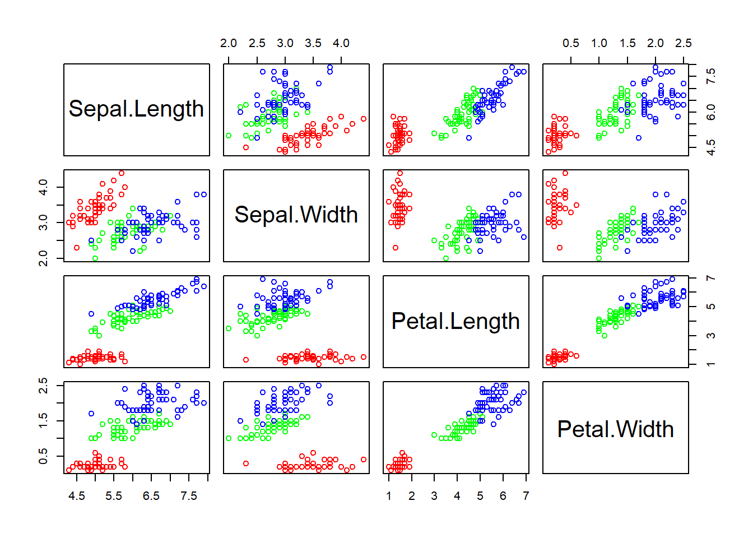
Feature Distribution Analysis
Visualizing Clusters
Analyzing the relationship between Petal Length and Petal Width reveals distinct botanical groupings.
•
Linear Separation: Setosa is perfectly linearly separable from other species.
•
Feature Importance: Petal dimensions offer higher discriminatory power than Sepal features.

Slide 6
Model Implementation
Training Strategy and Validation Framework

Slide 7



The Random Forest Framework
Ensemble Method
Constraint: Max Depth
Reproducibility
Uses Bootstrap Aggregation to combine multiple decision trees for improved robustness.
Random State set to 0 to ensure consistent results across different environment runs.
Set to 2 to prevent overfitting and ensure the model generalizes well to new samples.

Slide 8
Data Partitioning Strategy
70/30
Validation Integrity
We implemented a 70% Training and 30% Testing split to rigorously validate model performance.
•
Training Set: 105 total samples.
•
Testing Set: 45 unseen samples.

Slide 9
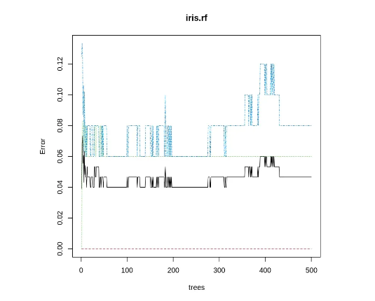
Hyperparameter Optimization
Estimator Sensitivity
Analyzing how the number of trees (n_estimators) impacts global model accuracy.
The model demonstrates stability and convergence as the estimator count increases beyond 50 trees, reaching its performance peak.

Slide 10
Classification Report
Class | Precision | Recall | F1-Score | Support
Setosa | 1.00 | 1.00 | 1.00 | 16
Versicolor | 1.00 | 0.94 | 0.97 | 18
Virginica | 0.92 | 1.00 | 0.96 | 11
ACCURACY |  | 0.98 | 45

Slide 11
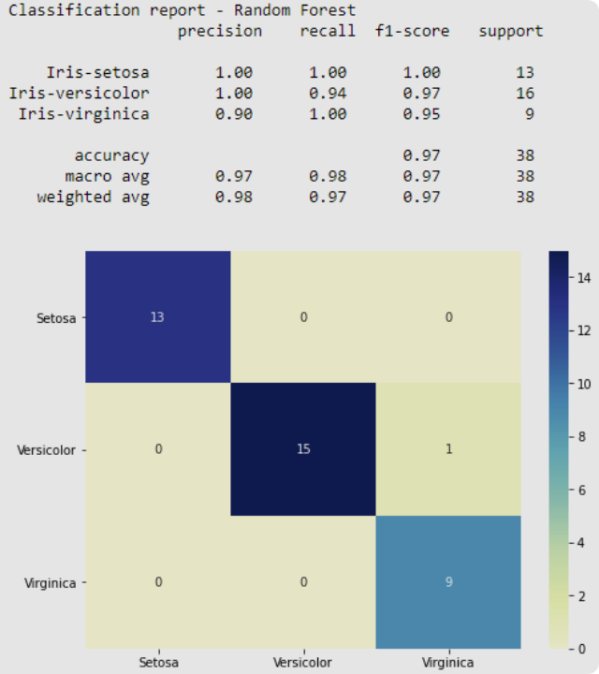

Error Matrix
Confusion Analysis
The matrix confirms near-perfect classification, with only a single instance of confusion between Virginica and Versicolor.
F1-Weighted Average: 0.98
Macro Average: 0.98

Slide 12
Conclusion & Questions
The Random Forest model effectively mastered Iris species identification with 98% accuracy.
Documentation Project completed in VS Code

